Slide 1


R Programming For Data Analysis

Slide 2

Agenda
Exploring Data With R
Data Types and Data Structure
Loops and Function In R
Fundamental in R
Matrices
Data Frames
Advanced Visualizaton With GGPlot

Slide 3

1
Exploring Data With R

Slide 4

Introduction to R
“R is a programming language and software environment for statistical computing and graphics. It is widely used among data scientists, statisticians, and researchers for data analysis, data visualization, and machine learning tasks.”
R is an open-source language, which means it is freely available and can be modified and distributed by anyone. The R software is maintained by the R Development Core Team and is supported by a large and active community of users and developers.
Some of the features that make R popular among data scientists and statisticians include its powerful data analysis and visualization capabilities, its support for a wide range of statistical techniques and models, and its ability to integrate with other programming languages and software tools.
R can be used for a variety of applications, including data cleaning and preprocessing, exploratory data analysis, statistical modeling, machine learning, and data visualization. It is also frequently used in research and academic settings, as well as in industry for applications such as financial analysis, marketing research, and predictive modeling.

Slide 5
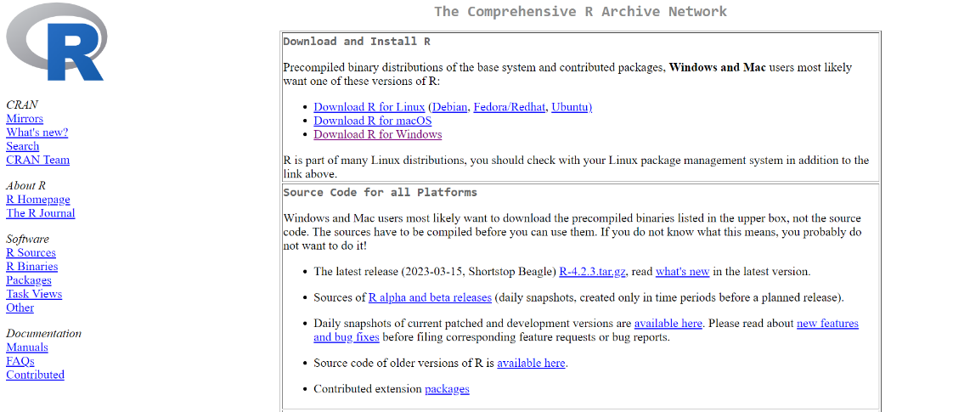
How to Download and Install R?
Here are some steps to get started with exploring R:
Install R on your computer: You can download R from the official website (https://cran.r-project.org/). R is available for Windows, Mac, and Linux operating systems.
Install an Integrated Development Environment (IDE): RStudio is a popular IDE for R. It provides a user-friendly interface for writing R code and analyzing data. You can download RStudio from its website (https://www.rstudio.com/).

Slide 6
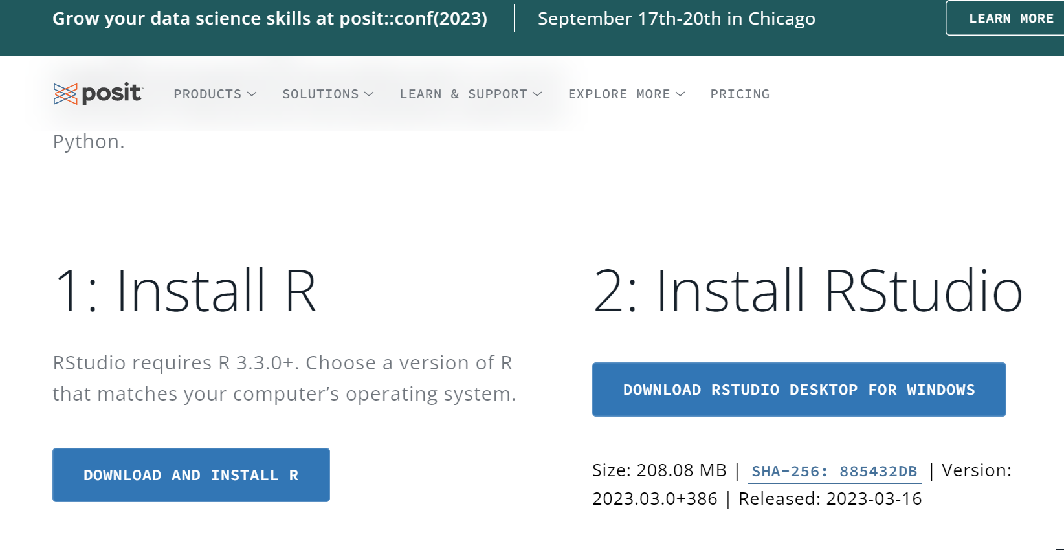

Slide 7

Features of R Programming
R is a programming language and environment that is widely used for statistical computing and graphics. Here are some of its key features:
Open-source: R is an open-source language, meaning that its source code is available to everyone, and it can be freely used and distributed.
Comprehensive: R has a comprehensive set of tools for data analysis, including statistical modeling, machine learning, data visualization, and data manipulation.
Object-oriented: R is an object-oriented language, which means that it uses objects to represent data and functions. This makes it easy to work with complex data structures.
Syntax: R has a simple and intuitive syntax that is easy to learn, even for people who don't have a background in programming.
Graphics: R has powerful graphics capabilities, allowing users to create a wide range of static and interactive visualizations.
Community: R has a large and active community of users and developers who contribute to its development and provide support through forums, mailing lists, and other resources.
Integration: R can be easily integrated with other programming languages, such as Python and SQL, as well as with other tools for data analysis, such as Excel and Tableau.
Packages: R has a large and growing collection of packages that extend its capabilities for specific tasks, such as time-series analysis, geospatial analysis, and network analysis.

Slide 8
2
Data Types And Data Structure

Slide 9
Data Types in R
R is a dynamic, object-oriented programming language that provides a wide range of data types for storing and manipulating data. Some of the commonly used data types in Rare:
Double
If you do calculation on numbers, you can use the data types double to represent the numbers.
Doubles are number like 3.14, 8.0 and 9.1. Doubles are used to represent continuous variables like the weight or length of a person.
X<- 6.14
Y<- 1.0
Z<- 7.0+13.9
Integer
Integer are natural numbers. They can be used to represent counting variables, for example the number of student in a class use the function as.integer to create objects of type integer.
Complex
Objects of types ‘complex’ are used to represent complex numbers. In statistical analysis you will not need them often. Use the function as.complex or complex to create objects of type complex.

Slide 10
Data Types in R
Logical
Logical data type is used to store Boolean values, which are either TRUE or FALSE.
Logical expression are often built from logical Operator:
1. Smaller than (<)
2. Larger than (>)
3. Smaller than or Equal to (<=)
4. Larger than or Equal to (>=)
5. Is Equal to (==)
6. Is unequal to (!=)
X<-c(9,166)
Y<-(3<x)&(x<=10)
Character
A character object is represented by a collection of characters between double quotes (“) for example: “x”, “test character” and “hello world!”. One way to create character objects is as follows.
X<-c(“a”, “b”, “c”)

Slide 11
Data Types in R
Date:
Date data type is used to store dates. In R, dates are represented by the "Date" class.
Time:
Time data type is used to store time. In R, times are represented by the "POSIXct" class.
Factors:
A factor is a data type used for categorical data. It is a vector of integers that have labels associated with them.

Slide 12
Data Structure in R
In R, there are many built-in data structures that can be used to organize and manipulate data. Some common examples of data structures in R include vectors, matrices, arrays, lists, and data frames.
Here's an example of each data structure:
Vectors: Vectors are one-dimensional arrays that can hold homogeneous data. They can be created using the c() function.
Matrices: Matrices are two-dimensional arrays that can hold homogeneous data. They can be created using the matrix() function.
Arrays: Arrays are multi-dimensional arrays that can hold homogeneous data. They can be created using the array() function.
Lists: Lists are a collection of objects that can be of different types and sizes. They can be created using the list() function.
Data frames: Data frames are two-dimensional objects that can hold heterogeneous data. They can be created using the data.frame() function.

Slide 13
3
Loop And Function IN R

Slide 14
Loops
In R, a loop is a programming construct that allows you to repeatedly execute a block of code. A loop can be useful when you need to perform a certain operation multiple times, such as processing a large data set.
For Loops
While Loops
Repeat Loops
If-else Loops
Switch

Slide 15
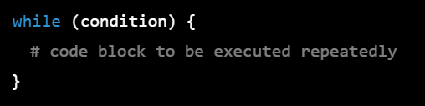
Loops
While Loop
In R programming language, a while loop is used to repeatedly execute a block of code until a certain condition is met. The syntax of a while loop in R is as follows:
The condition is an expression that is evaluated before each iteration of the loop. If the condition is TRUE, the code block is executed. After each iteration, the condition is evaluated again. The loop continues until the condition becomes FALSE.

Slide 16
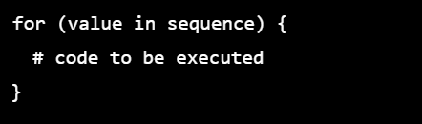
Loops
For Loop
The for loop is used to iterate over a sequence of values, such as a vector or a list. It has the following syntax:
For loops can be used in many different contexts in R, such as iterating over rows or columns of a data frame, performing calculations on a matrix, or generating sequences of numbers. The key is to identify the task you need to perform and then figure out how to use the loop construct to accomplish it.

Slide 17
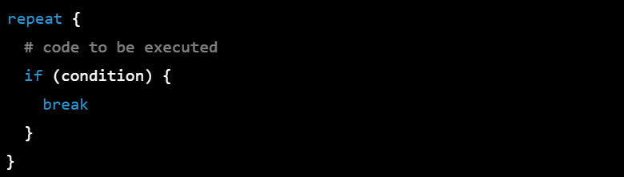
Loops
Repeat Loop
The repeat loop is used to repeatedly execute a block of code until a certain condition is met. It has the following syntax:

Slide 18
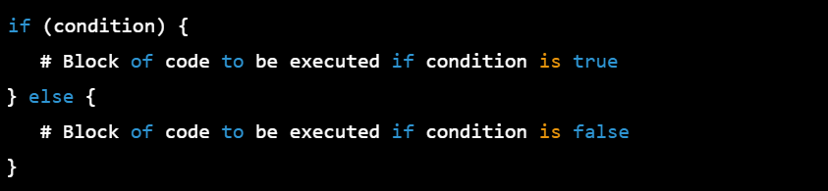
Loops
IF-Else
In R programming, the if-else statement is used to execute different blocks of code based on whether a specified condition is true or false. The basic syntax of if-else statement is:

Slide 19
Loops
Switch
In R programming, the switch function is used to select one of several alternatives based on the value of a given expression. It has the following syntax:
Here, EXPR is the expression whose value will be used to select the alternative. CASE1, CASE2, etc. are the different possible values that EXPR can take, and RESULT1, RESULT2, etc. are the corresponding results that will be returned if EXPR matches that case. DEFAULT is an optional argument that specifies what to do if EXPR doesn't match any of the cases.

Slide 20
Function In R Programming
In R programming, functions can be classified into two main types: pre-defined (or built-in) functions and user-defined functions.
Pre-defined functions are built-in functions that are available in R without the need to define them. These functions are written in the R language itself and are designed to perform common operations, such as mathematical calculations, data manipulation, and statistical analysis. Examples of pre-defined functions in R include mean(), sum(), sqrt(), and sd().
R programming language comes with a wide range of built-in functions that can be used for various purposes. Here is a list of some commonly used built-in functions in R:
Math Functions: abs, sqrt, exp, log, log10, cos, sin, tan, acos, asin, atan, ceiling, floor, round, trunc.
Statistical Functions: mean, median, sd, var, cor, cov, min, max, quantile, summary, density, ecdf, t.test, wilcox.test.
Data Manipulation Functions: cbind, rbind, subset, merge, aggregate, apply, tapply, sapply, lapply, reshape, dcast, melt.

Slide 21
Function In R Programming
Data Import and Export Functions: read.csv, read.table, write.csv, write.table, load, save.
Graphics Functions: plot, hist, boxplot, barplot, pie, lines, points, legend, title, text, abline.
Miscellaneous Functions: help, class, dim, length, names, str, summary, system.time, rm, print, rnorm(), c(), seq(), rep(), print(), is.numeric(), is.integer(), is.double(), is.character(), typeof(), sqrt(), paste(), #(comment).
These are just a few examples of the many built-in functions available in R. The R community has also developed many packages that extend the functionality of R with additional functions.
On the other hand, user-defined functions are functions that are created by the user to perform specific tasks that may not be covered by the pre-defined functions. These functions are defined using the "function" keyword in R and can be given any name that is not already used by a pre-defined function. Once defined, user-defined functions can be called and used like any other pre-defined function in R.
In R programming, a function is a set of instructions that performs a specific task. Functions are defined using the function() keyword and can take zero or more arguments as input and can return a value or an object.
Here is the basic syntax for creating a function in R:

Slide 22
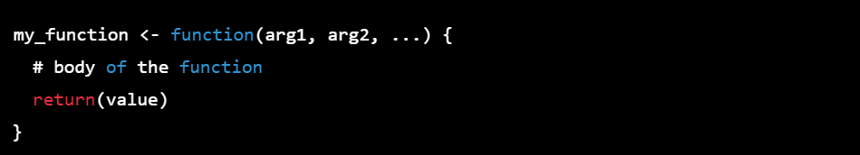
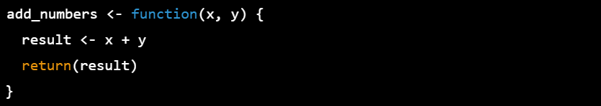
Here, my_function is the name of the function, arg1, arg2, etc. are the arguments that the function takes as input, and value is the value that the function returns.
For example, here is a simple function that adds two numbers together and returns the result:

Slide 23
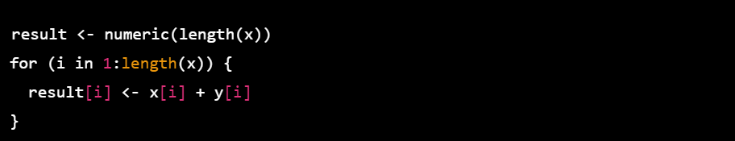
Vectorized Functions and Environments in R Programming
In R programming, vectorization is the process of performing operations on entire vectors of data rather than individual elements. Vectorized functions take advantage of this feature to operate on entire vectors of data, which can significantly improve computational efficiency.
If we wanted to add these two vectors together element-wise, we could use a loop to iterate over each element:
Alternatively, we could use a vectorized function like + to add the vectors together:

Slide 24
This approach is more efficient because it avoids the overhead of the loop.
Environments in R are objects that contain variables and their values. Each environment has a parent environment, which can be thought of as a container that encloses the environment. The global environment is the top-level environment that contains all the variables that are defined in the current R session.
Environments can be useful for managing and organizing variables in complex R programs. For example, you can create a new environment to store variables related to a specific task, and then pass that environment to functions that need access to those variables
Overall, vectorized functions and environments are two important features of R programming that can help improve the efficiency and organization of your code.

Slide 25
The Apply Family of Functions in R Programming
In R, the "Apply" family of functions is a set of functions that are used to apply a specific function to a set of data elements, such as a matrix, a data frame or a list. The "Apply" functions are particularly useful when working with large datasets, as they provide a way to efficiently perform operations on groups of data without having to write complicated loops.
Here are some of the most commonly used "Apply" functions in R:
apply(): This function applies a function to either rows or columns of a matrix or data frame.
lapply(): This function applies a function to each element of a list and returns a list.
sapply(): This function is similar to lapply(), but it tries to simplify the result to a vector or matrix if possible.
mapply(): This function applies a function to multiple lists or vectors element-wise.
These functions provide an efficient and easy-to-use way to apply a function to a set of data elements in R. By using these functions, you can simplify your code and save time when working with large datasets.

Slide 26
4
Fundamental In R

Slide 27
What is Vector in R Programming?
In R programming, a vector is a basic data structure that represents an ordered collection of elements of the same data type. It can be created using the c() function or by coercing other data structures such as lists or matrices using the as.vector() function.
Vectors can be of different data types such as numeric, character, logical, and complex. They can also have different lengths and can be indexed using numerical or logical values.
Let’s Create Some Vectors
There create some vector as :
Creating a numeric Vector:
To create a numeric vector, use the c() function and separate the values with commas:

Slide 28
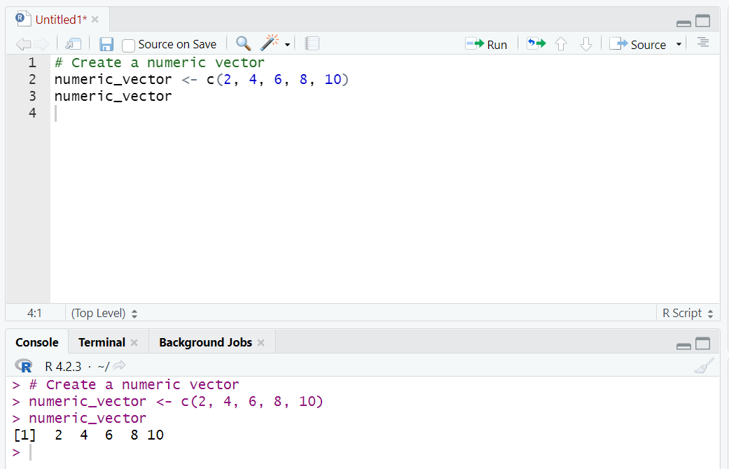
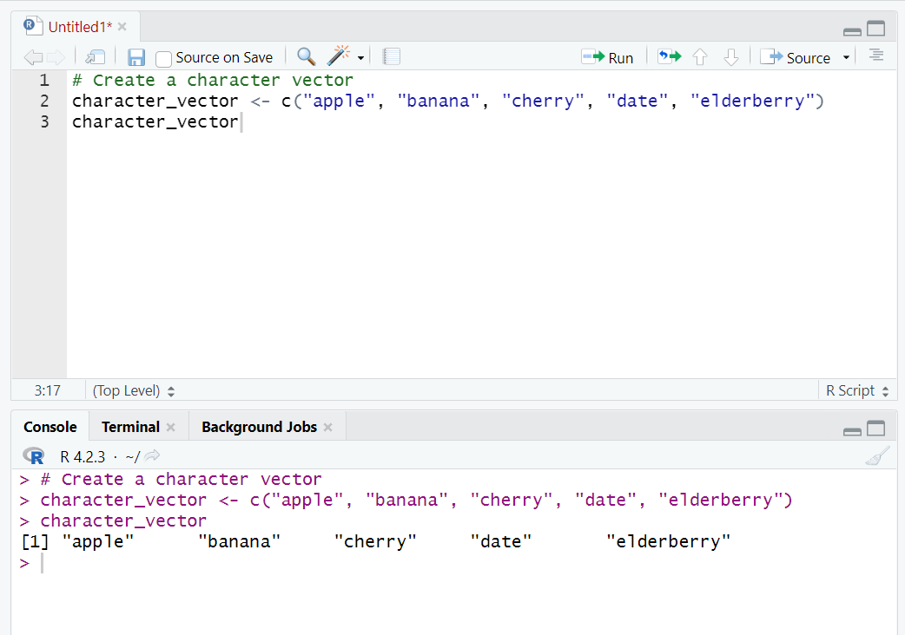
Creating a Character Vector:
To create a character vector, use the c() function and enclose the values in quotes:

Slide 29
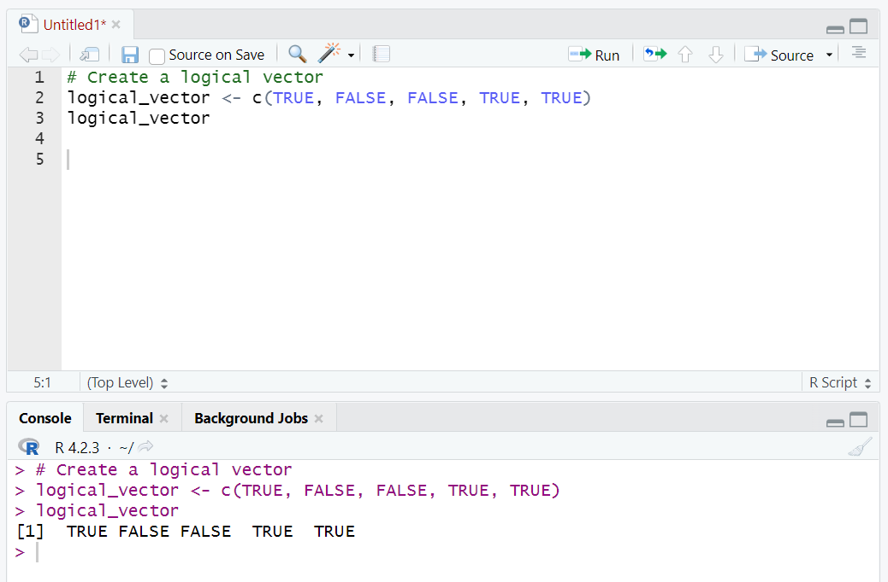
Creating a Logical Vector:
To create a logical vector, use the c() function and enclose the values in TRUE or FALSE:
Creating a Sequence Vector:
To create a sequence vector, use the : operator to define a range of values:

Slide 30
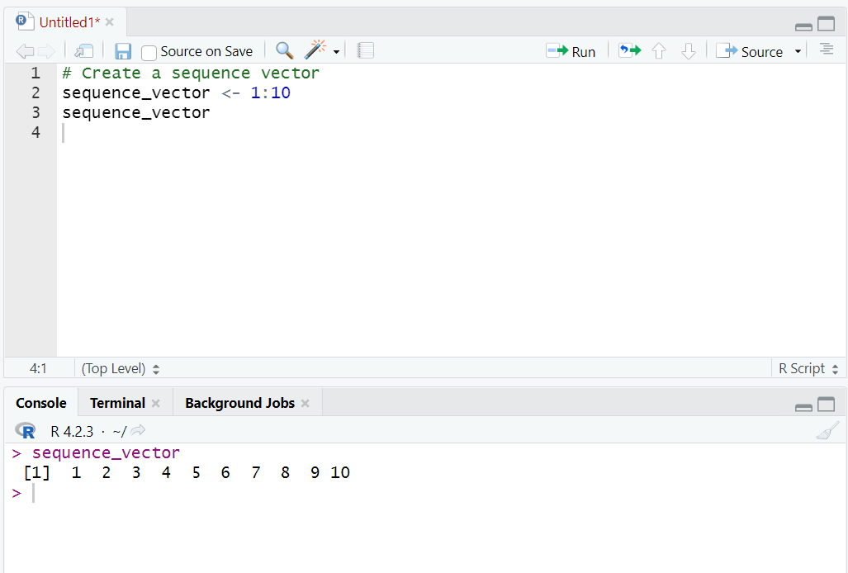
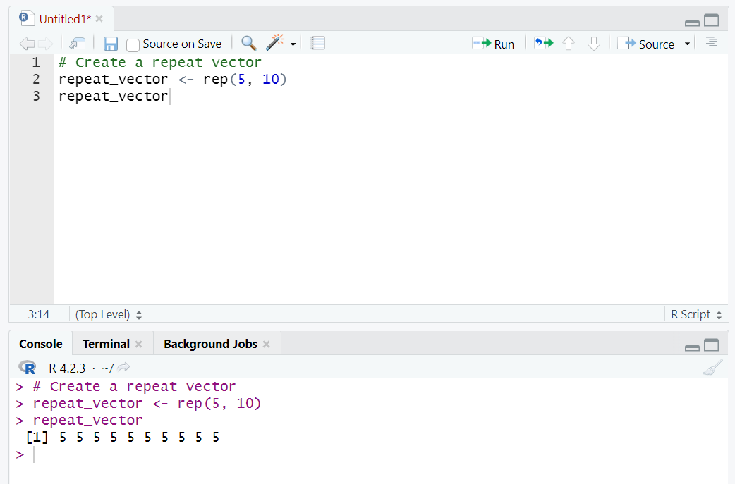
Creating a Repeat Vector:
To create a repeat vector, use the rep() function and specify the value and number of times to repeat:

Slide 31
How to Install Packages in R?
To install packages in R, you can use the install.packages() function. Here are the steps:
1)Open R or RStudio.
2)Make sure you have an active internet connection.
3)Type the following command in the R console or in an R script:
Replace package_name with the name of the package you want to install. For example, to install the tidyverse package, you would type:

Slide 32
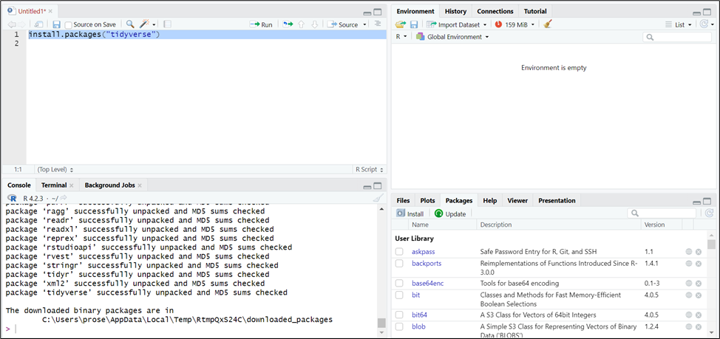

Slide 33
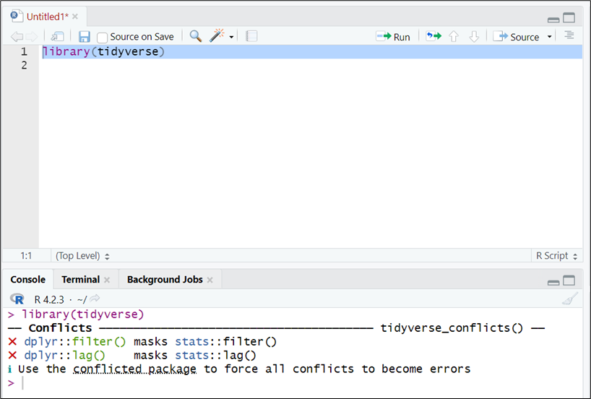
4)Press Enter.
5)R will download the package from the CRAN (Comprehensive R Archive Network) and install it on your computer. This may take a few minutes, depending on the size of the package and your internet connection.
6)Once the installation is complete, you can load the package into your R session using the library() function. For example, to load the tidyverse package, you would type:
That's it! You can now use the functions and features of the installed package in your R code.

Slide 34
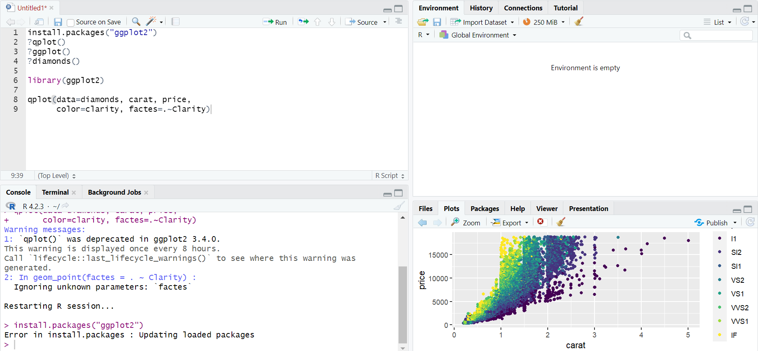

Slide 35
5
Matrices

Slide 36
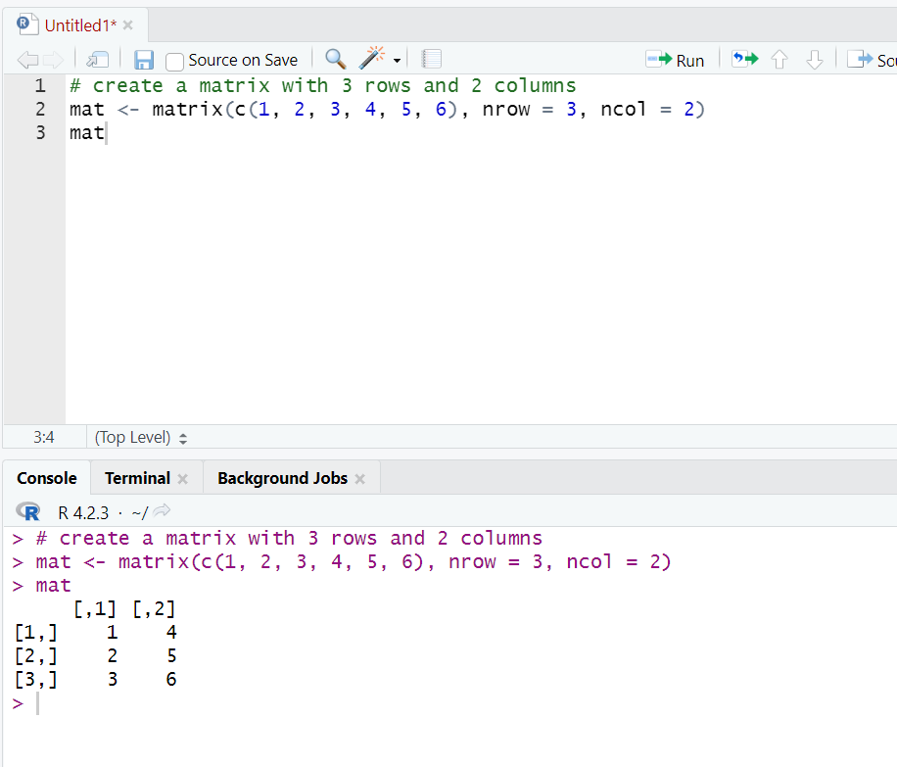
Matrices
In R, a matrix is a two-dimensional array-like structure that contains elements of the same data type. Matrices are useful for performing mathematical operations such as linear algebra, and they can be created and manipulated using various functions and operations in R.
Here's how to create a matrix in R:
Use the matrix() function to create a matrix. The matrix() function takes two arguments: the data elements to populate the matrix and the number of rows and columns in the matrix.

Slide 37
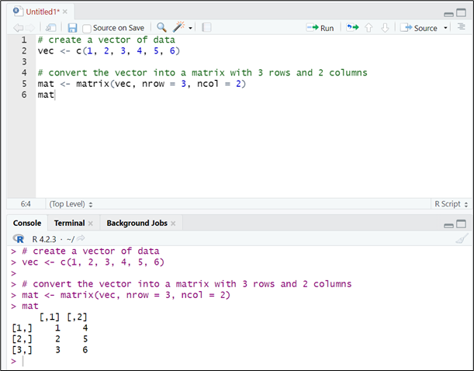
You can also create a matrix by converting a vector into a matrix using the matrix() function and specifying the number of rows and columns.

Slide 38
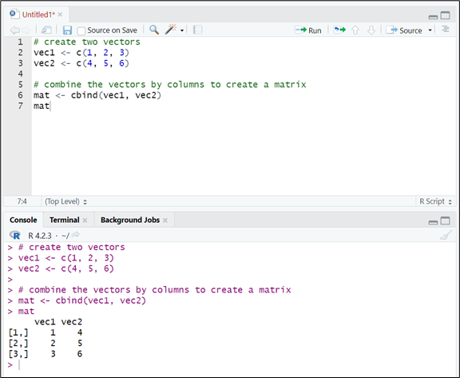
You can also create a matrix using the cbind() or rbind() functions to combine vectors into a matrix by columns or rows, respectively.
You can manipulate matrices using various functions and operations in R. For example, you can access individual elements of a matrix using indexing (mat[row, column]) or select a subset of a matrix using slicing (mat[row_start:row_end, col_start:col_end]). You can also perform mathematical operations on matrices such as addition, subtraction, multiplication, and division using the standard arithmetic operators (+, -, *, /).

Slide 39
Naming Dimensions
In R, naming dimensions refers to the process of assigning names to the dimensions of an array or matrix. This can be useful for making the data more interpretable and for indexing the data using the names of the dimensions rather than the numeric indices.
To assign names to the dimensions of an array or matrix, you can use the dimnames() function. The dimnames() function takes one or more arguments, where each argument is a character vector of names for the corresponding dimension. The length of each character vector must match the length of the corresponding dimension.
For example, consider a matrix mat with 3 rows and 4 columns:
You can assign names to the rows and columns of the matrix using dimnames():
Now, you can access the elements of the matrix using the names of the rows and columns:

Slide 40
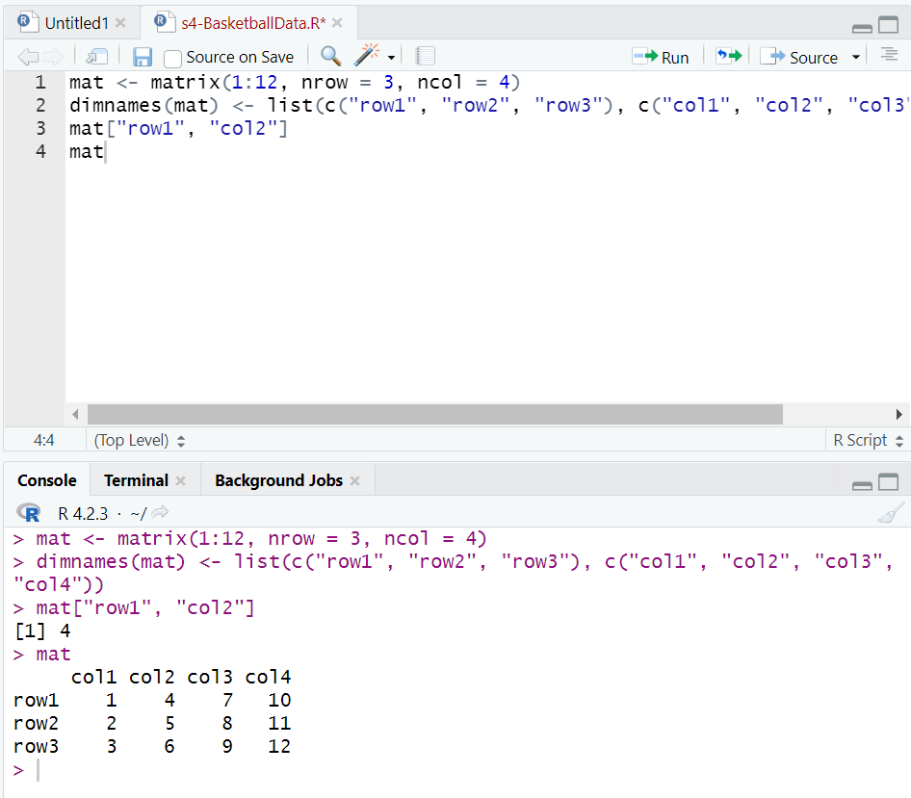
Similarly, you can assign names to the dimensions of an array. The dimnames() function takes a list of character vectors, where each character vector contains names for the corresponding dimension. The order of the character vectors in the list corresponds to the order of the dimensions in the array.

Slide 41
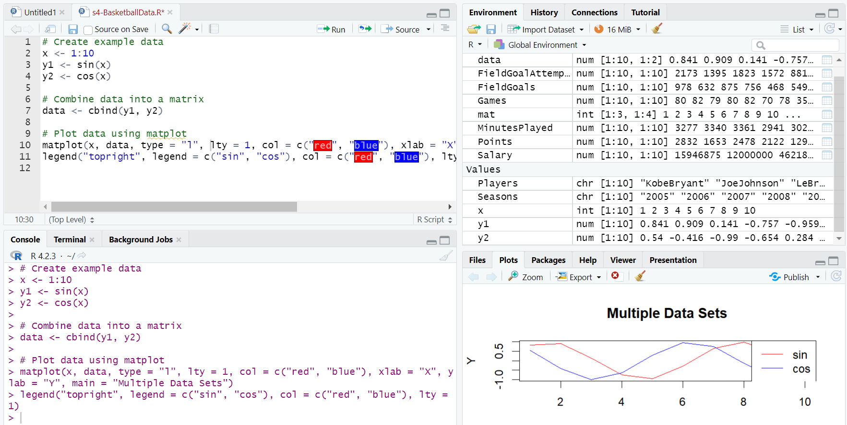
Visualizing with Matplot
In R, the matplot() function is used to visualize multiple sets of data on the same plot. The matplot() function takes a matrix or data frame as input, where each column corresponds to a different set of data to be plotted.
Here's an example of using matplot() to plot two sets of data:

Slide 42
In this example, x is a vector of x-coordinates, and y1 and y2 are vectors of y-coordinates for two different sets of data. The cbind() function is used to combine y1 and y2 into a matrix data.
The matplot() function is then used to plot the data. The first argument to matplot() is the x-coordinates (x), and the second argument is the matrix of y-coordinates (data). The type argument specifies that a line plot should be used (type = "l"), and the lty and col arguments are used to specify line style and color for each set of data.
The xlab, ylab, and main arguments are used to add labels and a title to the plot, and the legend() function is used to add a legend to the plot.
This code produces a plot with two lines, one for sin(x) and one for cos(x), with the x-axis labeled "X", the y-axis labeled "Y", and a title "Multiple Data Sets". A legend is also included in the plot to indicate which line corresponds to which set of data.

Slide 43
Subsetting in R
Subsetting in R means selecting a subset of a data object (such as a vector, matrix, or data frame) based on certain conditions or criteria. There are several ways to subset data in R, including:
Using square brackets [ ]: You can use square brackets to extract a subset of a data object based on the indices of the elements you want to select. For example, to extract the second and fourth elements of a vector named "x", you can use:
You can also use logical expressions inside the square brackets to select elements based on a certain condition. For example, to select all elements in a vector named "x" that are greater than 5, you can

Slide 44
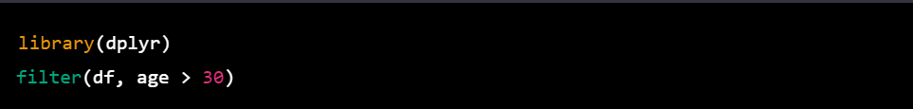
Using the subset() function: The subset() function allows you to select rows of a data frame based on logical expressions. For example, to select all rows in a data frame named "df" where the value in the "age" column is greater than 30, you can use:
Using the filter() function (dplyr package): The filter() function from the dplyr package is another way to select rows of a data frame based on logical expressions. For example, to select all rows in a data frame named "df" where the value in the "age" column is greater than 30, you can use:
These are just a few examples of the many ways you can subset data in R. It's important to choose the appropriate method based on the type of data object you are working with and the specific subset you want to extract.

Slide 45
6
Data Frames

Slide 46
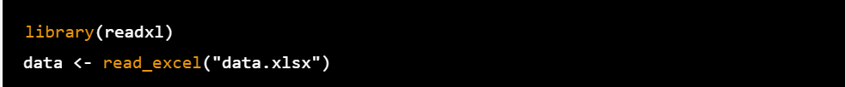
Importing Data In R
To import data in R, there are several options depending on the format of the data. Here are some commonly used methods:
CSV file: Use the read.csv() function to import data from a CSV file. For example, if your CSV file is named "data.csv" and is located in the working directory, you can import it like this:
Excel file: Use the readxl package to import data from an Excel file. First, you need to install the package by running install.packages("readxl"). Then, you can use the read_excel() function to import the data. For example

Slide 47
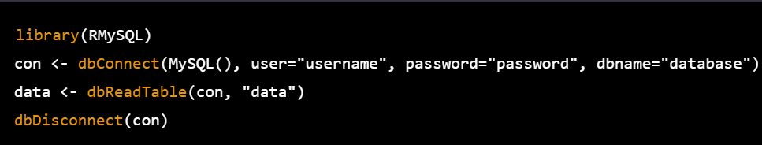
Text file: Use the read.table() function to import data from a text file. For example, if your text file is named "data.txt" and is tab-separated, you can import it like this:
SQL database: Use the RMySQL or RODBC package to connect to a SQL database and import data. For example, to connect to a MySQL database and import a table named "data", you can use the following code:

Slide 48
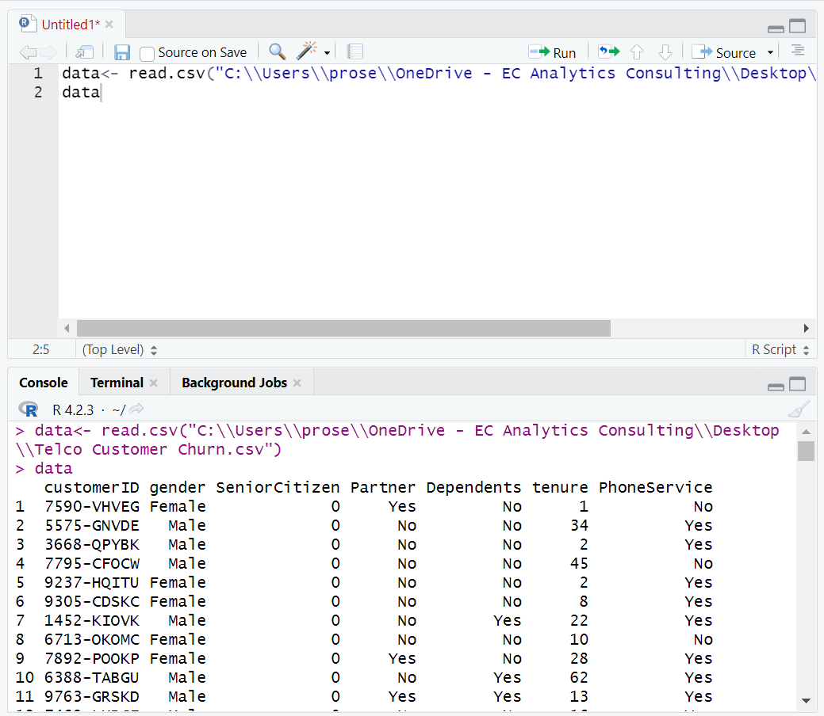
Note that you need to replace "username", "password", and "database" with your own information. The RODBC package works in a similar way, but can connect to other types of databases as well.

Slide 49
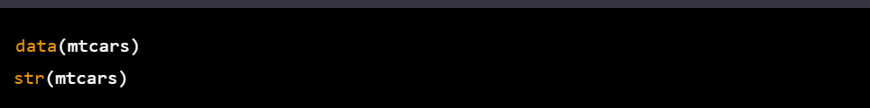
Exploring Your Dataset in R
Exploring a dataset is an important first step in any data analysis project, and R provides many useful tools for doing so. Here are a few key functions you can use to explore your datasets in R:
str(): The str() function provides a quick way to inspect the structure of a dataset. It shows the data type and dimension of each variable in the dataset. For example:
This will display information about the "mtcars" dataset, including the names of the variables, their data types, and the number of observations.
summary(): The summary() function provides a summary of the distribution of each variable in the dataset. For numeric variables, it shows the minimum, maximum, median, and quartiles. For categorical variables, it shows the frequency of each level. For example:

Slide 50
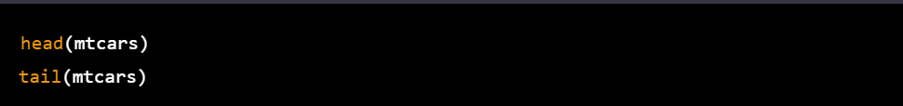
This will display a summary of the "mtcars" dataset, including the mean, median, and quartiles of the numeric variables, and the frequency of each level for the categorical variables.
head() and tail(): The head() and tail() functions provide a quick way to view the first or last few rows of a dataset. For example:
This will display the first and last few rows of the "mtcars" dataset.
unique(): The unique() function provides a list of unique values for a variable in the dataset. For example:

Slide 51
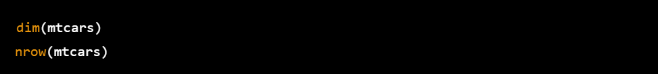
This will display the unique values of the "gear" variable in the "mtcars" dataset
dim() and nrow(): The dim() and nrow() functions provide information about the dimensions of the dataset. dim() returns a vector of the number of rows and columns in the dataset, while nrow() returns the number of rows only. For example:
This will display the number of rows and columns in the "mtcars" dataset, and the number of rows only.
These are just a few examples of the many functions available in R for exploring datasets. By using these and other functions, you can gain a better understanding of the data you are working with, and identify potential issues or areas of interest for further analysis.

Slide 52
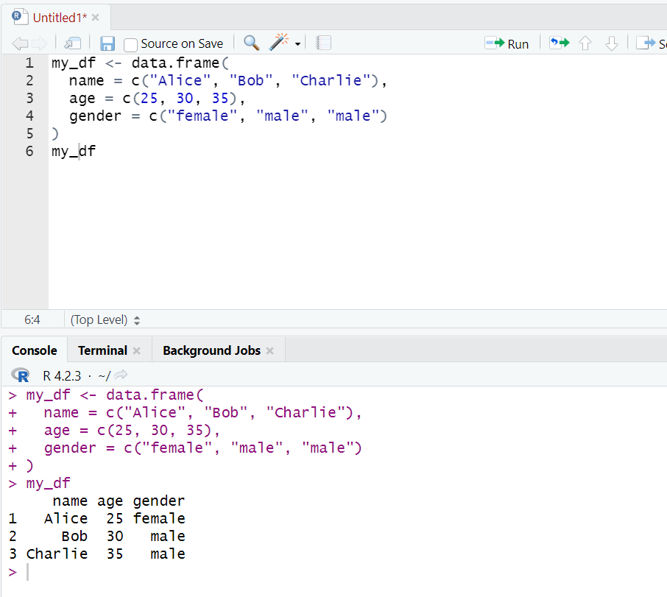
Basic Operation with Data Frames in R
Data frames are one of the most commonly used data structures in R, and they allow you to store and manipulate tabular data. Here are some basic operations you can perform with data frames in R:
Creating a data frame:

Slide 53
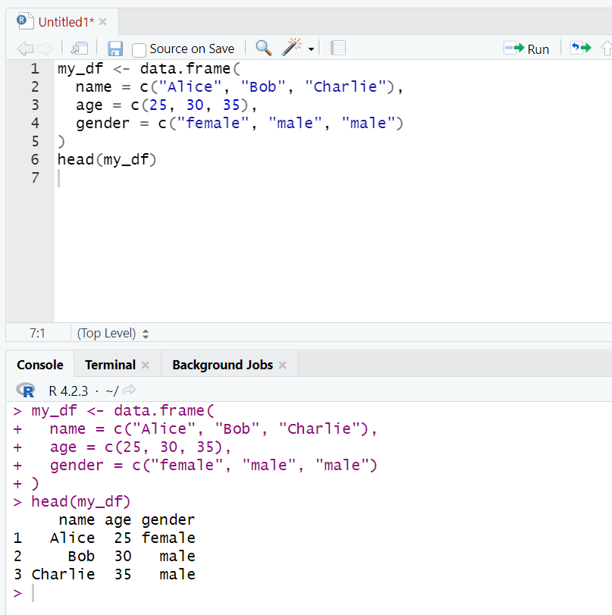
Viewing a data frame:

Slide 54
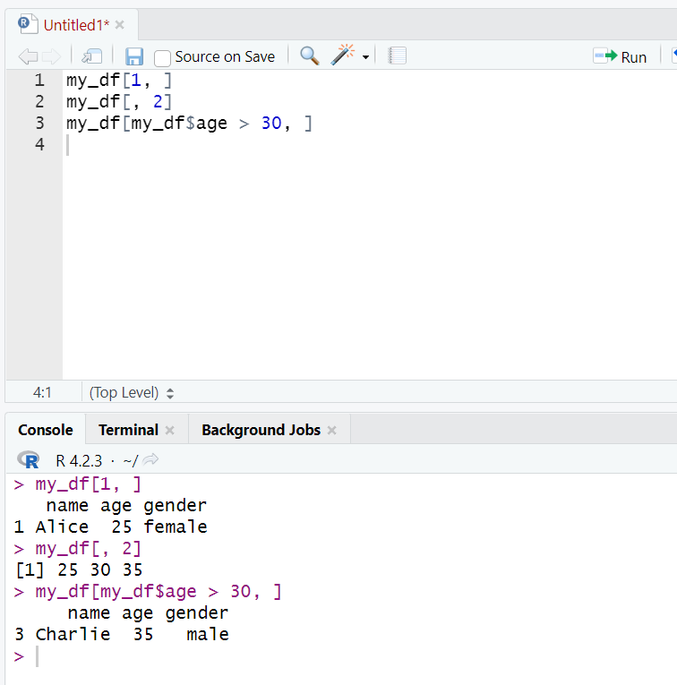
Subsetting a data frame:

Slide 55
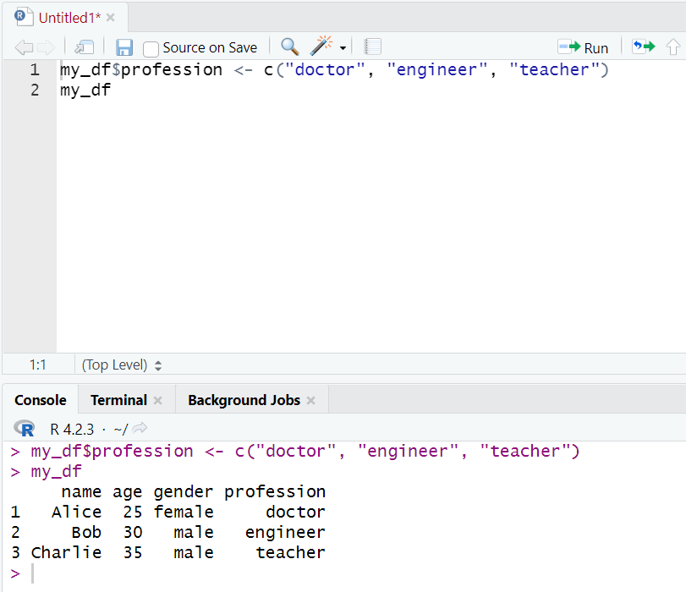
Adding a new column to a data frame:

Slide 56
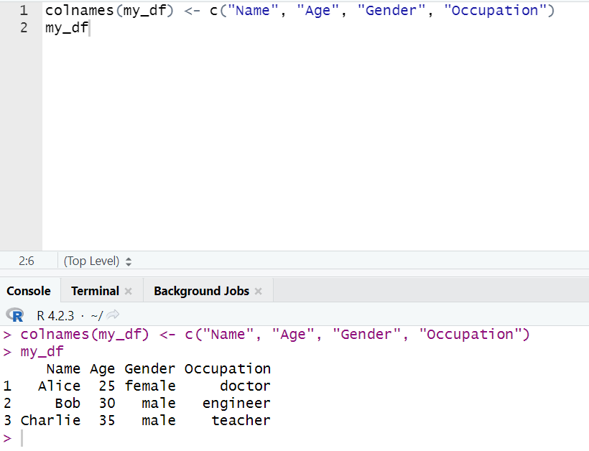
Renaming columns in a data frame:

Slide 57
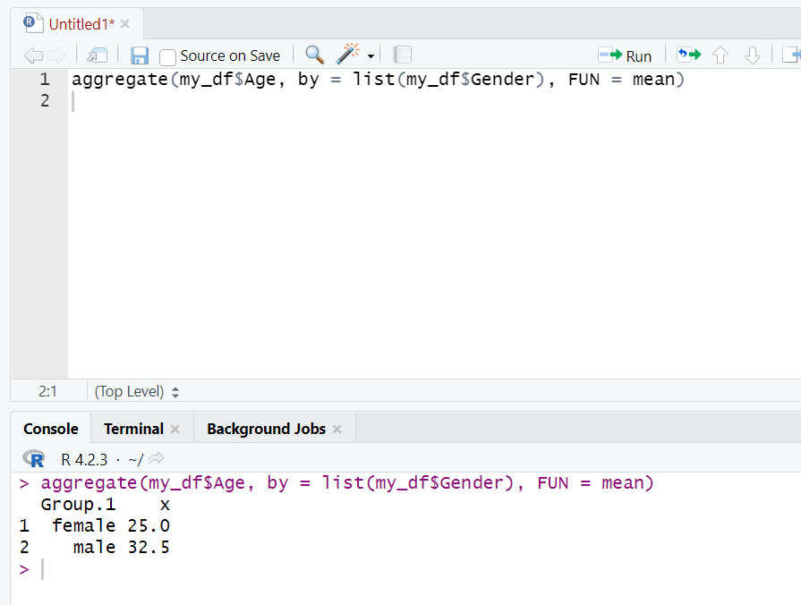
Aggregating data in a data frame:

Slide 58
7
Advanced Visualization With GGPlot

Slide 59
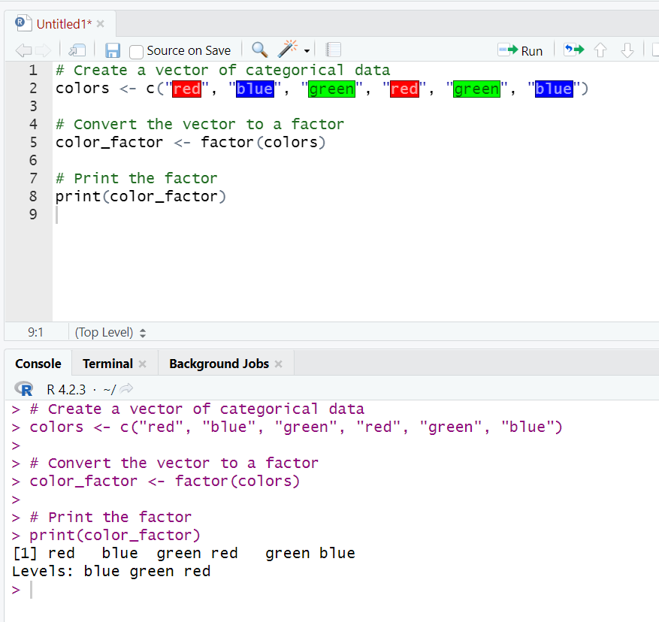
What is Factor?
In R, a factor is a data object that represents categorical or nominal data. It is used to store data that belongs to a fixed set of categories, where each category is represented by a unique value, called a level.
For example, suppose we have a dataset containing information about the color of cars. The color column would be a categorical variable, and the possible categories would be "red", "blue", "green", etc. We can represent this variable as a factor in R by assigning each category a level.
To create a factor in R, we can use the factor() function. The function takes a vector of categorical data and converts it into a factor object. We can also specify the levels of the factor, which determines the unique values that can be assigned to the factor.
Here's an example of how to create a factor in R:

Slide 60
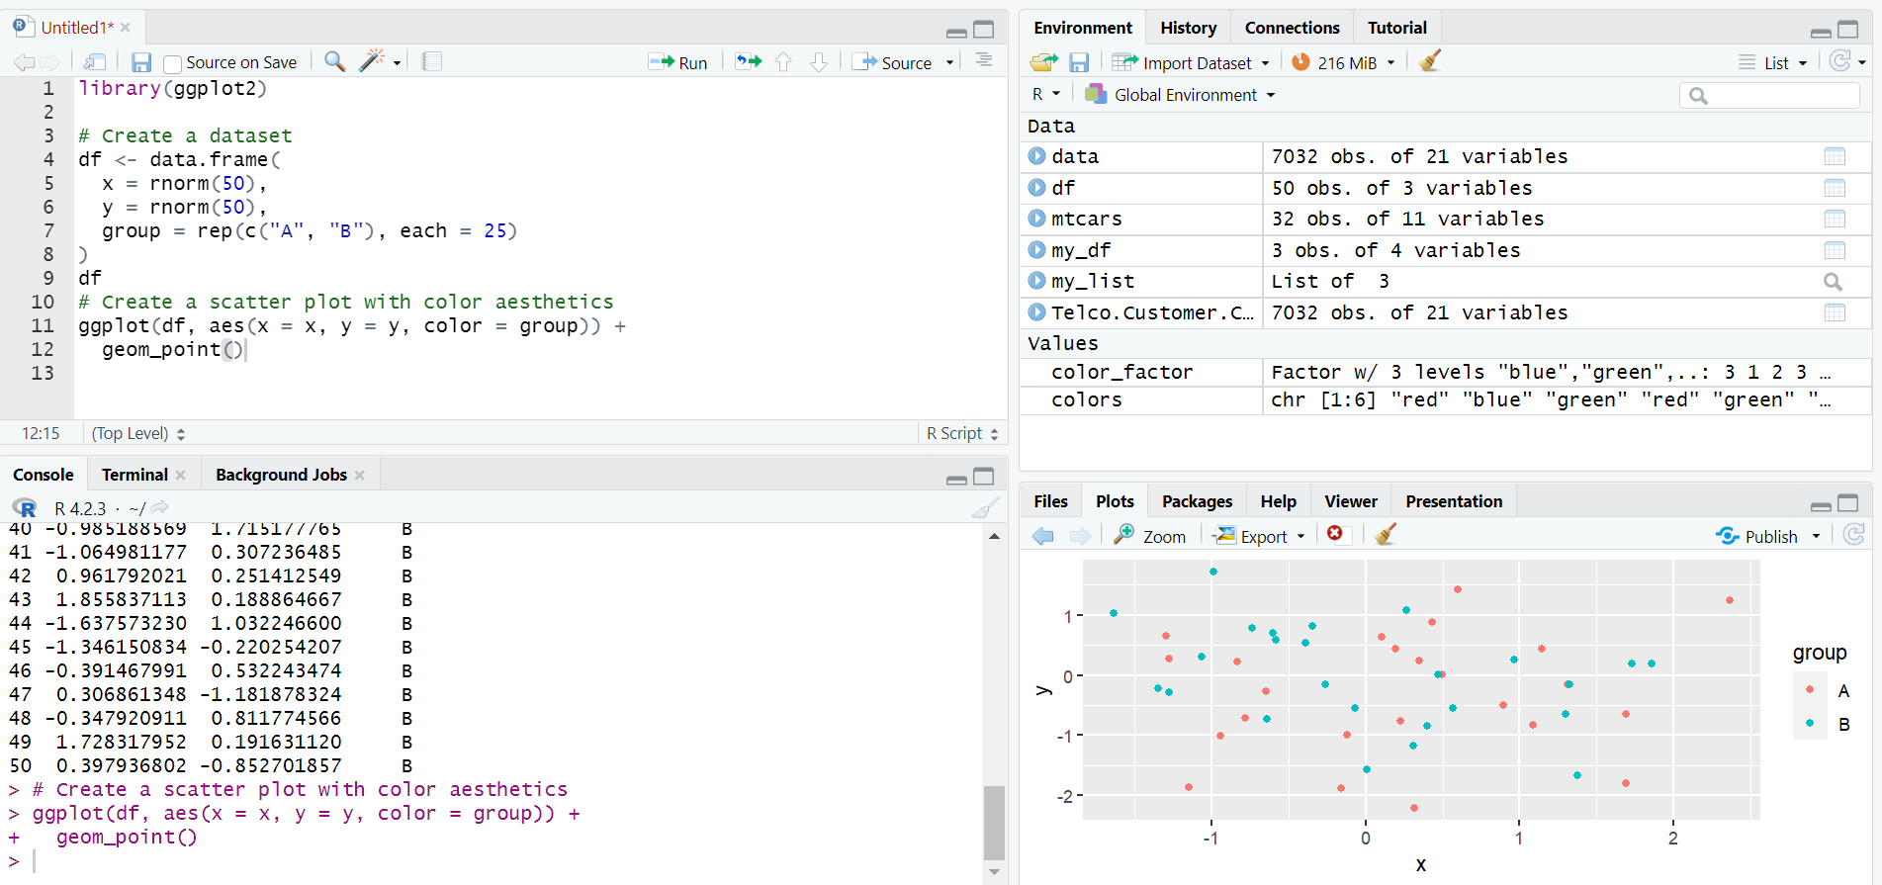
Aesthetic
In R, the term "aesthetic" refers to a visual property of a plot, such as the color, shape, size, or position of the plot elements. Aesthetics are typically defined using the aes() function in R, which is used to map variables in a dataset to the visual properties of a plot.
For example, let's say we have a dataset with columns for x, y, and group. We can create a scatter plot of x and y, and color the points based on the group column using the aes() function as follows:
In this example, the aes() function is used to specify the x and y variables for the plot, and the color aesthetic is used to map the group variable to the color of the points. This results in a scatter plot where the points are colored differently based on their group membership.
Aesthetics can also be modified using various geom_* functions in R, which are used to add different types of geometric objects to a plot (e.g., points, lines, bars, etc.) and modify their visual properties. For example, the geom_point() function is used to add points to a scatter plot, and the size parameter can be used to modify the size of the points. Similarly, the geom_line() function is used to add lines to a plot, and the linetype parameter can be used to modify the type of line.

Slide 61
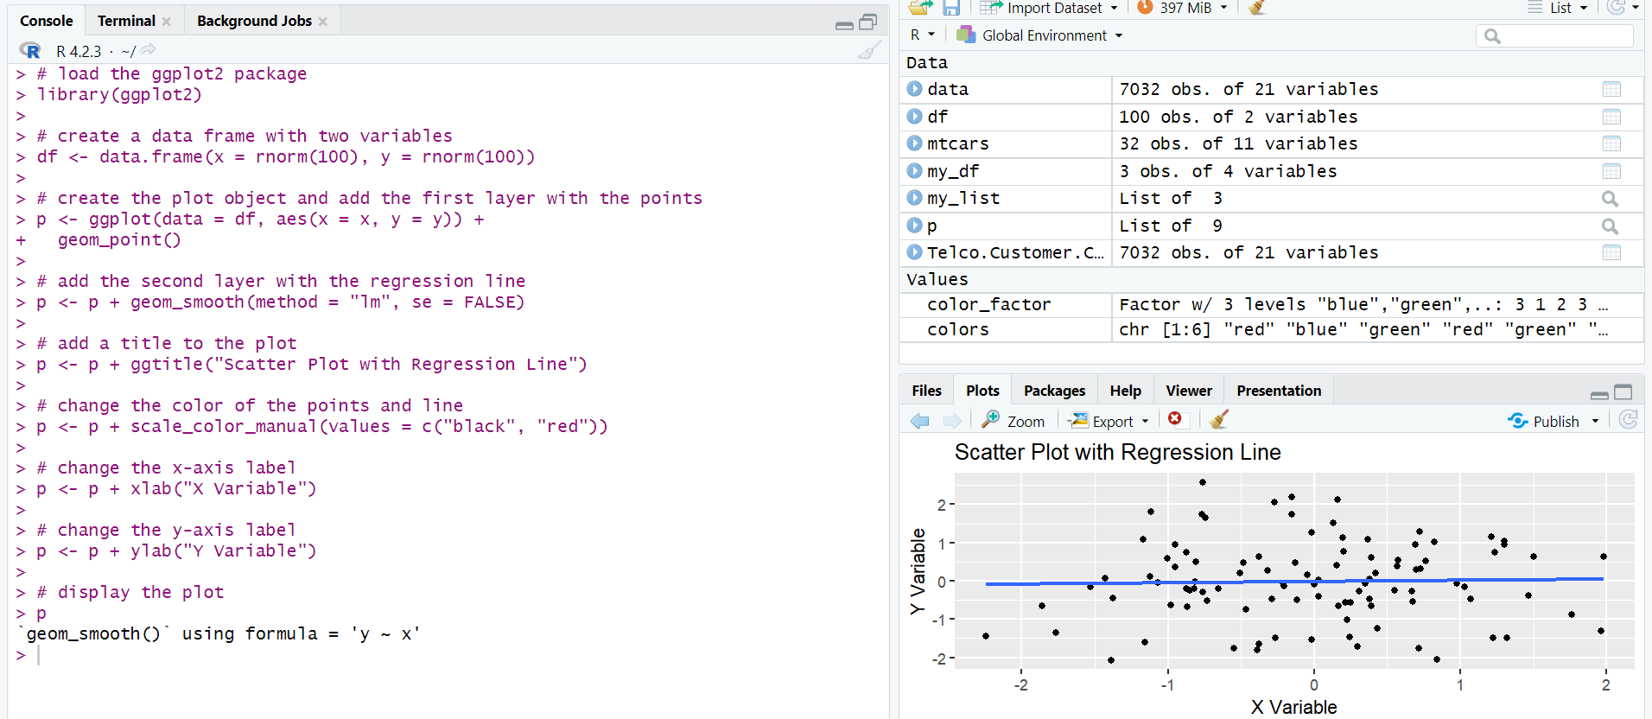
Plotting with Layer in R
In R, there are several ways to create plots, and one of them is by using the ggplot2 package, which uses the concept of layers to build the plot.
Here is an example of creating a scatter plot with a regression line using ggplot2 and adding layers to customize the plot:
In this example, we first create a data frame with two variables, x and y, using the rnorm function to generate random normal values.
We then create the plot object, p, by using the ggplot function and specifying the data frame and the variables to use for the x and y axes. We add the first layer to the plot using the geom_point function to plot the points.
We then add a second layer to the plot using the geom_smooth function with the method argument set to "lm" to add a linear regression line to the plot. We also set the se argument to FALSE to remove the shaded area around the line.
We customize the plot further by adding a title using the ggtitle function, changing the colors of the points and line using the scale_color_manual function, and changing the x and y axis labels using the xlab and ylab functions.
Finally, we display the plot using the plot object p.

Slide 62
Mapping Vs Setting in R
In R, mapping and setting can refer to different concepts depending on the context of the analysis. Here are some possible interpretations of these terms in R:
Mapping:
In data analysis, mapping can refer to the process of transforming data from one form to another, such as converting categorical variables into numerical values or summarizing data by groups. This can be done using functions like map, apply, or lapply in R.
In spatial analysis, mapping can refer to the visualization of geographical data, such as creating maps of locations, boundaries, or patterns. This can be done using packages like ggplot2, leaflet, or mapview in R.
In machine learning, mapping can refer to the process of fitting a model to data by finding a mathematical function that can predict an outcome variable based on input features. This can be done using functions like lm, glm, or randomForest in R.
Setting:
In R, setting can refer to the configuration of various options and parameters that control the behavior of R functions and packages. For example, you can set the working directory, change the plot colors, or adjust the memory allocation using functions like setwd, par, or options in R.
In data analysis, setting can refer to the context in which data is collected or analyzed, such as the sampling method, data cleaning procedures, or data transformations. These settings can have a significant impact on the validity and reliability of the results.
In statistical modeling, setting can refer to the assumptions and conditions that are made about the data and the model, such as the distributional assumptions, the linearity assumptions, or the homoscedasticity assumptions. These settings can affect the accuracy and precision of the model predictions.

Slide 63
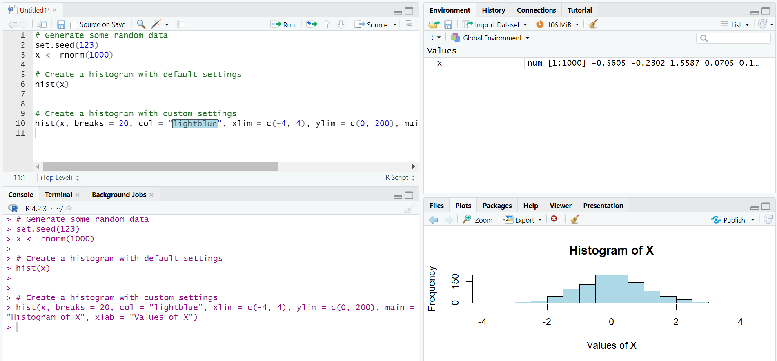
Histogram and Density chart in R
In R, you can create histograms and density plots using various built-in functions and packages. Here are some examples of how to create these charts in R:
Histogram:
To create a histogram in R, you can use the hist() function. Here's an example:

Slide 64
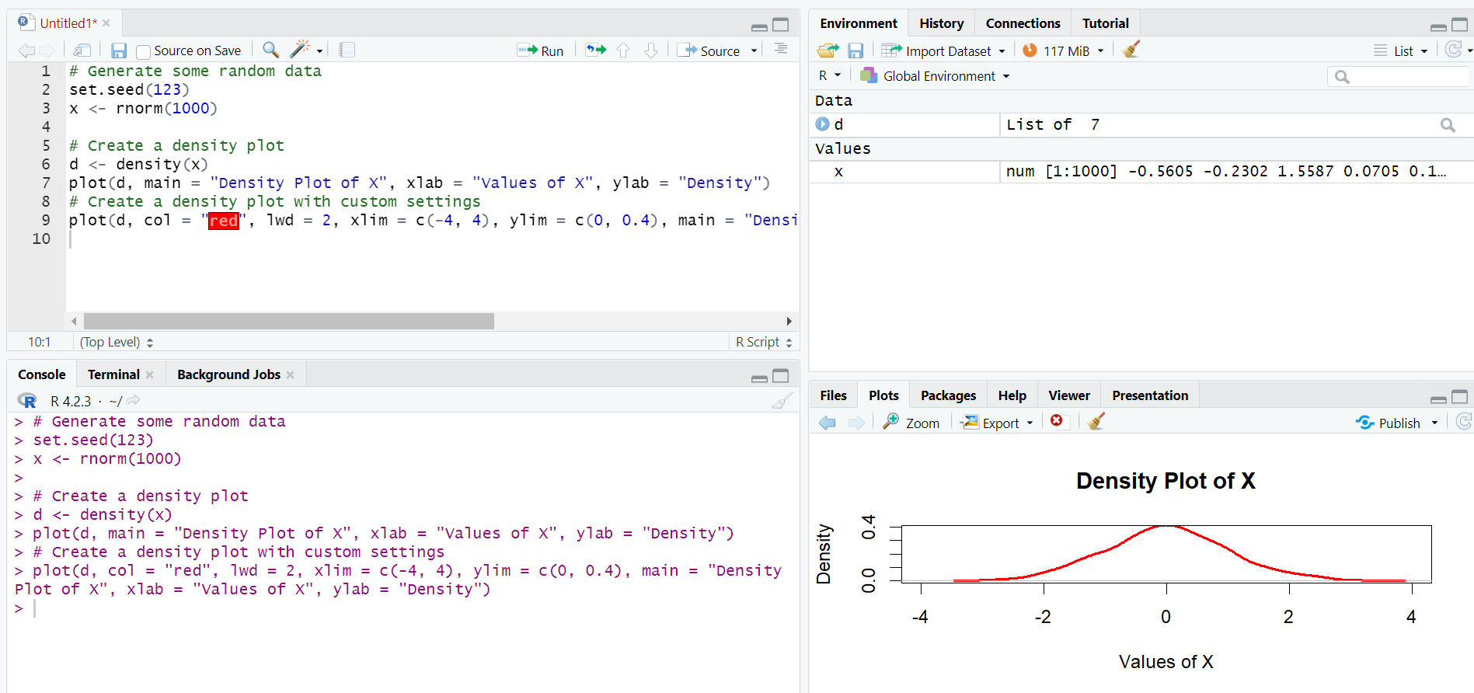
Density plot:
To create a density plot in R, you can use the density() function to estimate the probability density function (PDF) of the data, and then plot the result using the plot() or lines() functions. Here's an example:

Slide 65
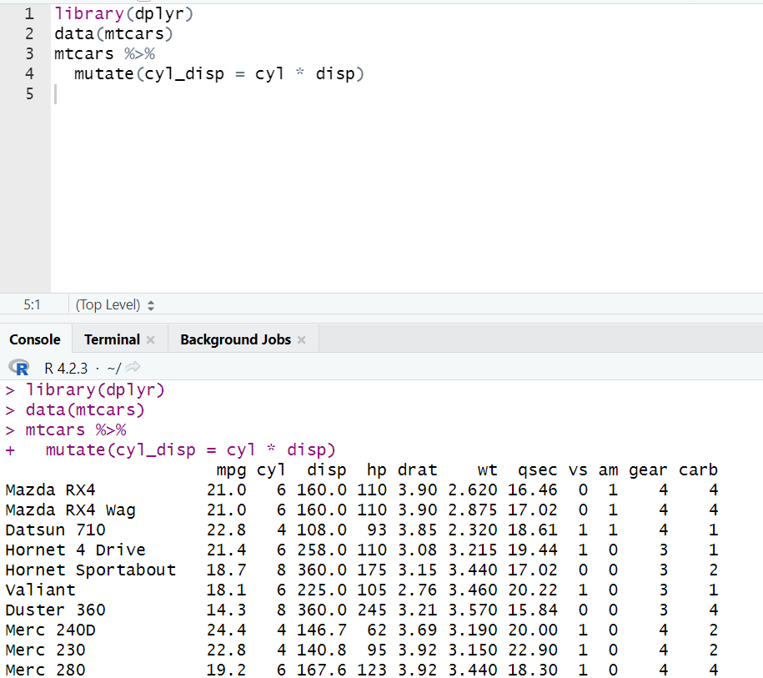
Statistical transformations
Statistical transformations are used in data analysis to create new variables from existing variables by applying mathematical functions or operations to them. In R, statistical transformations can be performed using various functions and packages. Here are a few examples:
dplyr package: The dplyr package is a popular package for data manipulation in R. It provides a set of functions for filtering, summarizing, grouping, and transforming data. One of the most commonly used functions in dplyr for statistical transformation is mutate(). This function is used to create new variables by applying mathematical functions to existing variables. Here's an example
This code creates a new variable cyl_disp by multiplying the values of cyl and disp columns in the mtcars data frame

Slide 66
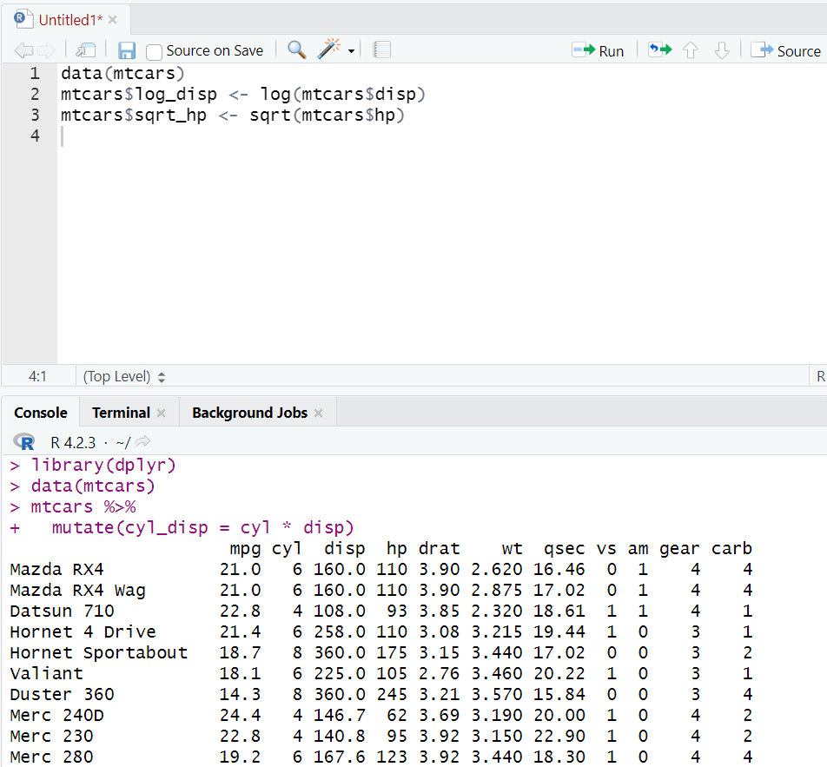
base R functions: R also provides several base functions for statistical transformations. For example, the log() function can be used to compute the natural logarithm of a variable, while the sqrt() function can be used to compute the square root of a variable. Here's an example:
This code creates two new variables log_disp and sqrt_hp by applying the log() and sqrt() functions to the disp and hp columns, respectively.

Slide 67
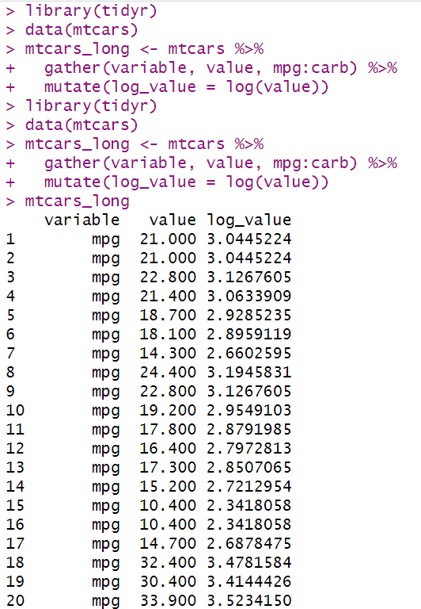
tidyr package: The tidyr package is another popular package for data manipulation in R. It provides functions for reshaping data, such as gather() and spread(), which can also be used for statistical transformation. Here's an example:
This code reshapes the mtcars data frame into a longer format using the gather() function and creates a new variable log_value by applying the log() function to the value column.
These are just a few examples of how statistical transformations can be performed in R. There are many other functions and packages that can be used for this purpose depending on the specific requirements of the analysis.

Slide 68
Thank You

